Slide 1
SUPPLY CHAIN ANALAYSIS
Domain: Fast Moving Consumer Goods (FMCG)

Slide 2
Problem Statement
AtliQ Mart is a growing FMCG manufacturer headquartered in Gujarat, India. It is currently operational in three cities Surat, Ahmedabad and Vadodara. They want to expand to other metros/Tier 1 cities in the next 2 years.
AtliQ Mart is currently facing a problem where a few key customers did not extend their annual contracts due to service issues. It is speculated that some of the essential products were either not delivered on time or not delivered in full over a continued period, which could have resulted in bad customer service.
Management wants to fix this issue before expanding to other cities and requested their supply chain analytics team to track the ’On time’ and ‘In Full’ delivery service level for all the customers daily basis so that they can respond swiftly to these issues.

Slide 3
OBJECTIVE
The supply chain team decided to use a standard approach to measure the service level in which they will measure ‘on-time delivery (OT) %’, ‘in-full delivery (IF) %’, and on time in full (OTIF) %’ of the customer orders daily basis against the target service level set for each customer.

Slide 4
BUSINESS TERMS
LIFR% ( Line Fill Rate) - Number of orders lines shipped in Full Quantity / Total Order Lines
VOFR% (Volume Fill Rate) - Volume Fill Rate – Total Quantity Shipped / Total Quantity Ordered
OT% ( On Time) - On Time Delivery – Number of Orders delivered on Time/Total Number of Orders
IF% ( In Full) – In Full Delivery – Number of Orders delivered in Full quantity/Total Number of Orders
OTIF%(On time In Full) Delivery – Orders delivered both In full and On time/Total Number of Orders

Slide 5
DASHBOARD

Slide 6
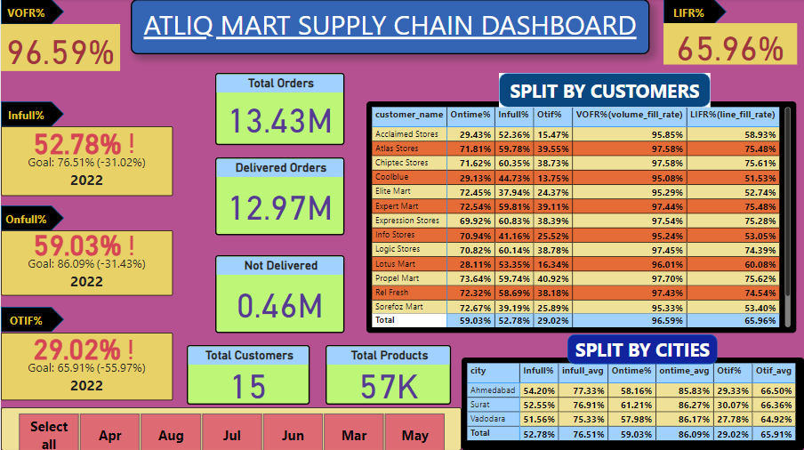

Slide 7
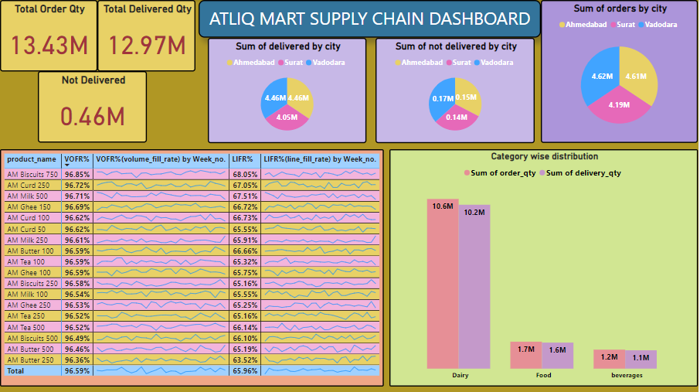

Slide 8
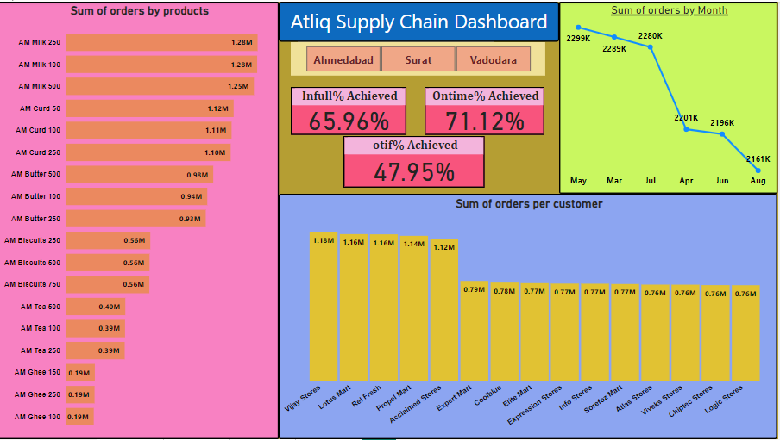

Slide 9
INSIGHTS
Milk is the most ordered product followed by Curd and Butter
Maximum orders are getting placed from dairy category. It contributes 67% of total order lines. There is a high demand in dairy products.
Lotus Mart, Acclaimed Stores and Vijay Stores are significant customers who are placing maximum orders.
Lotus Mart, Acclaimed Stores and Cool blue are facing major issues in delivery. OTIF Rate for these customers are lower as compared to other customers. Improving their metrics should be our priority to retain these customers.
All the key metrics like IF%, OT%, and OTIF% are way behind their targets.

Slide 10
RECOMMENDATIONS
Focus to increase dairy products as the demand foe these products is twice as compared to others.
A real time monitoring system to keep track of all the important key metrics and fast resolution.
Taking feedback from customers to understand the challenges.
Tailor city-specific strategy to increase and meet the order demands.

